Slide 1
Blindness Detection on Diabetic Retinopathy Images
Team 4: Xiaoyu Wan, Yonghao Duan, Yu Sun

Slide 2
Agenda
Problem Statement
Dataset Overview
Exploratory Data Analysis (EDA)
Data Preprocessing
Modeling
Result and Discussion
Future Studies

Slide 3
Problem Statement
1
Notes:
Yu Sun

Slide 4
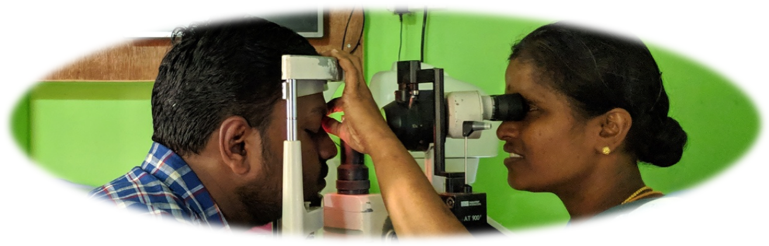
Problem Statement
Diabetic retinopathy (DR) is an eye disease with retina damage caused by diabetes
DR affects > 80% of patients who have diabetes > 20 years
DR is a leading cause of blindness
Early diagnosis of DR can be achieved by non-invasive retinal photography
Our goal: Train an image classifier to predict the severeness of DR
Notes:
Goal of analysis
Aravind Eye Hospital in India hopes to detect and prevent diabetic retinopathy among people living in rural areas where medical screening is difficult to conduct.
Diabetic retinopathy (DR) is a leading cause of blindness and affects up to 80 percent of those who have had diabetes for 20 years or more.

Slide 5
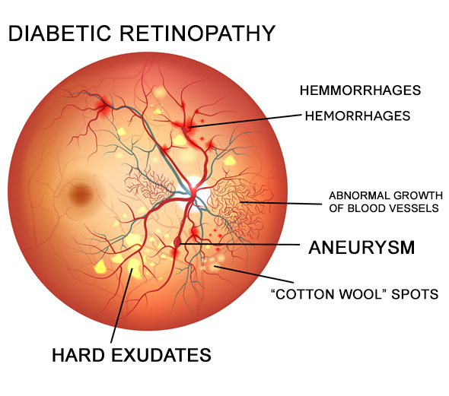
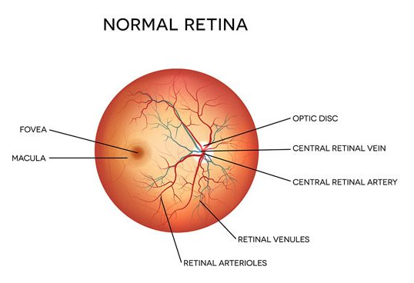
Diabetic Retinopathy

Slide 6
Dataset Overview
2
Notes:
Yu Sun

Slide 7
Dataset Overview
Data Sources:
Kaggle datasets
Aravind Eye Hospital, India
Retinal photography
(color images)
2019: main dataset
2015: augmented dataset
Data Details:
2019 dataset: 3,662 images, 8.3 G
2015 dataset: 35,108 images, 8.5 G
(80% training, 20% validation)
Labels
1,928 test images
0: Normal 3: Severe
1: Mild 4: Proliferative DR
2: Moderate
Notes:
Data Source: kaggle
How they collect the data--how the label was done
Size-Train and Test Sets (size and numbers)
2019 only: 3662 (2930 training, 732 valid)
Aravind Eye Hospital in India hopes to detect and prevent diabetic retinopathy among people living in rural areas where medical screening is difficult to conduct

Slide 8
Exploratory Data Analysis
3
Target Label Distribution
Train/Test Set Image Overview
Notes:
Xiaoyu Wan

Slide 9
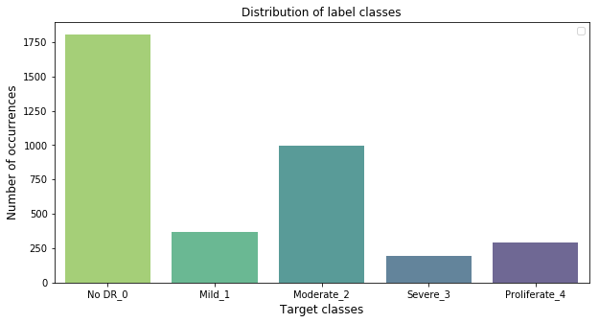
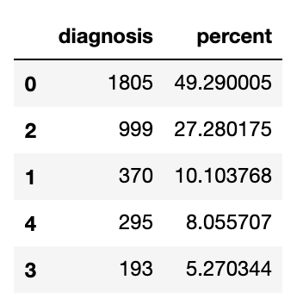
Target Label Distribution
FInding:
Imbalanced distribution of the target label are found. The most class class_0 is around 10 times of class_3.
Action:
Address class imbalance using oversampling and downsampling techniques and data Augmentation.
Figure: Train Set target label distribution (Label 0-4).
Notes:
As it was shown on the left, the largest number of class is the class_0 with no diabetic retinopathy. And the smallest number of class is class_3, the severe symptoms. As you can see here, the ratio of class_0 to class_3 is approaching to 10:1, so the imbalanced class is one of the issue to address here. The oversampling and downsampling techniques will be disscussed later.

Slide 10
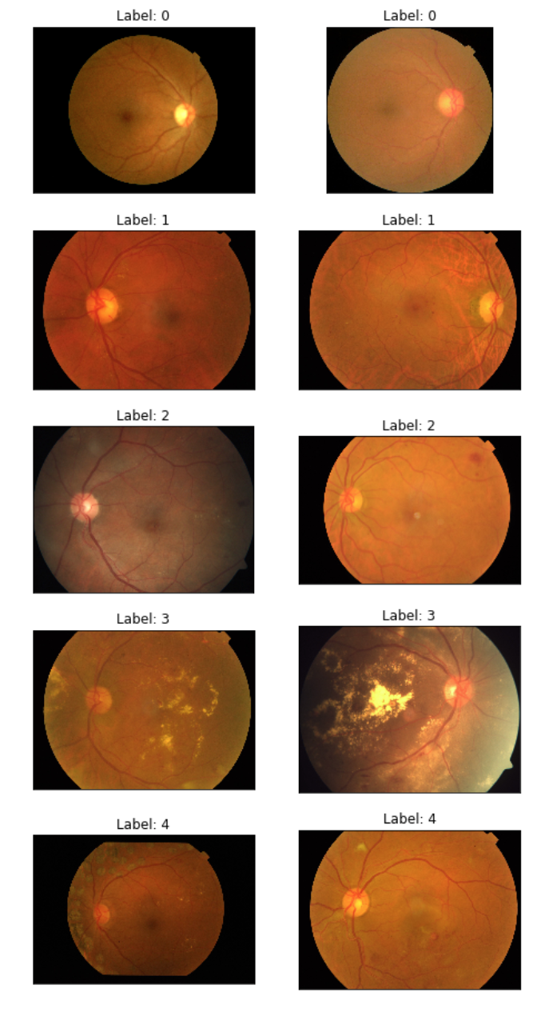
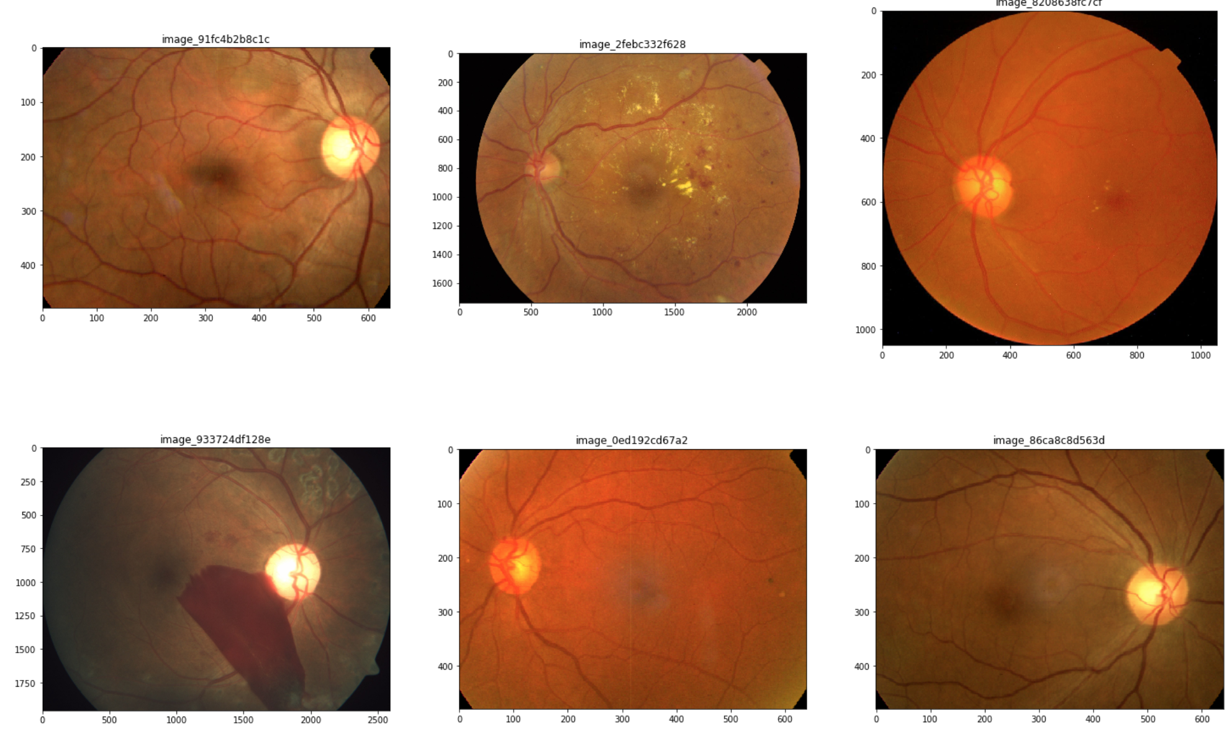
Train/Test Set Images Overview
Findings:
From Class_1 to Class_4, the hard exudates and cotton wool are easier to find.
Large variations between image sizes.
The brightness of images and contrast are helpful to detect the disease.
Focus and edges of images.
Actions: Image size, focus, color contrast
Figure Left: Train Set Image Samples (Label 0-4).
Figure Right: Test Set Image Samples.
Notes:
We right now presented you the tran set image on the left, and the test set image on the right. What is the message we got here? Number one, across the train label from 0 to 4 the hard exudates and cotton wool are spotted and visible. Number two, compared with the train set images and test datasets a large variation is found of the image sizes. Number 3 the brightness and contrast of images are helpful to detect the diseases.Number 4, the focus and edges of images varied. For the next, we are considering using some image transformation for adjusting the size, brightness and shifting the focus of the image.

Slide 11
Data Preprocessing
4

Slide 12
Data Preprocessing
Class Imbalance
-Add dataset from 2015
Over and Down Sampling
Data Transformation
Notes:
Xiaoyu Wan
画出一个经过处理的原图到改变后的结果图（展示用）

Slide 13
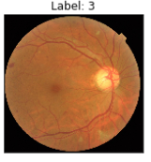
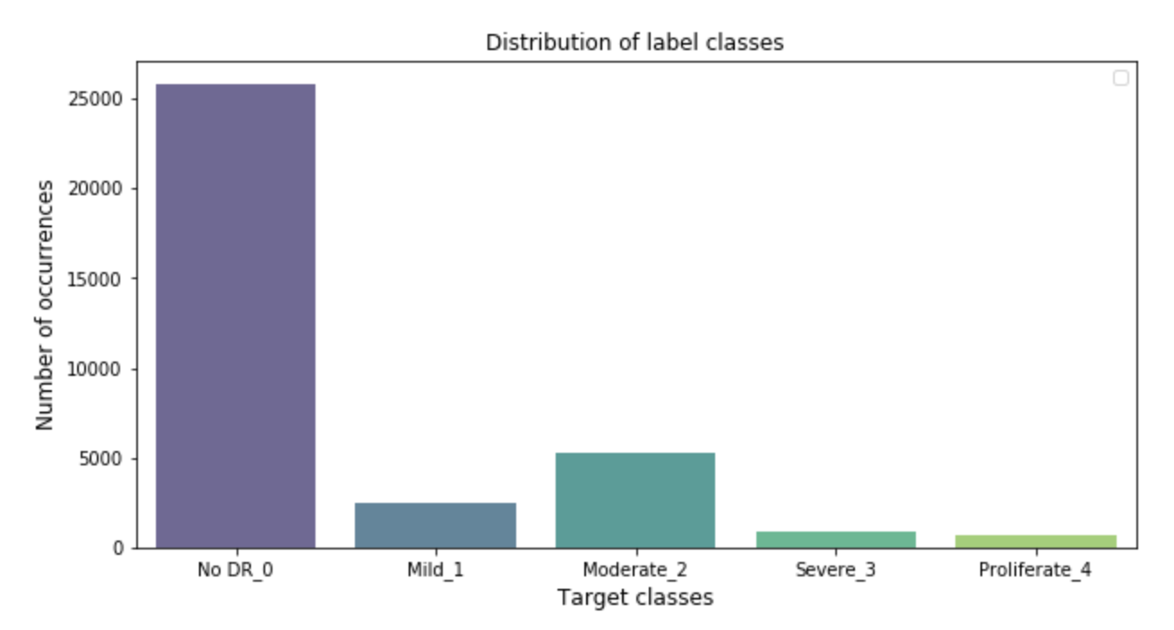
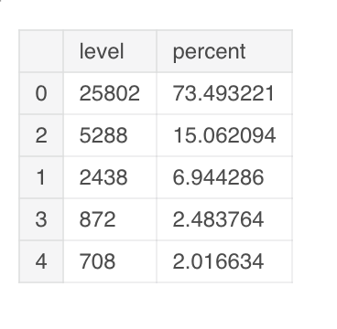
2015 Data
FIndings:
Larger size for each label
Similar distribution
Data are collected globally
Original data 82 GB
Resized and processed dataset 7G
Processed Methods:
Resize images to 1024 * 1024 * ratio
Crop the image by identifying the center and radius
Figure: Train Set target label distribution (Label 0-4) for 2015 data.

Slide 14
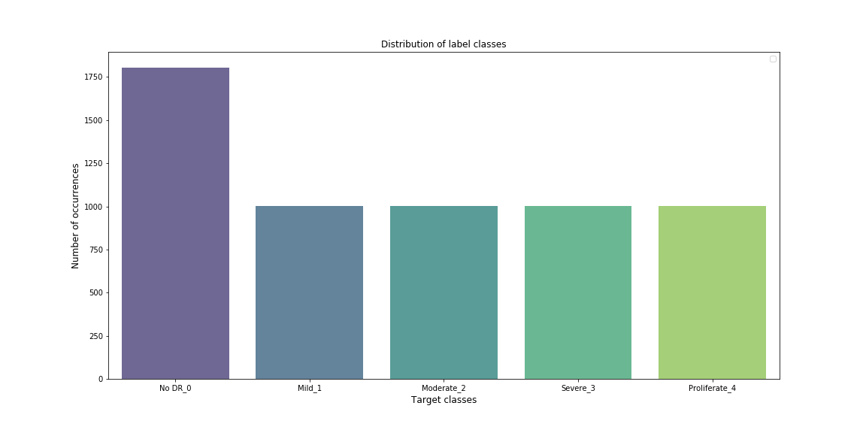
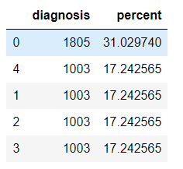
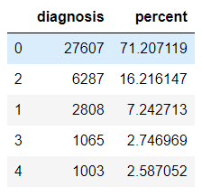
Over & Down Sampling
Step 1: Combine 2015 & 2019 datasets
Step 2: Over & Down Sampling
- Keep the class with smallest samples the same (class_4) as 2019
- Keep the class with largest class to the same size as 2019
- Keep the rest of classes as the same as the smallest class size.
Figure 1: Combined dataset proportion.
Figure 2: Distribution of target labels after processing.

Slide 15
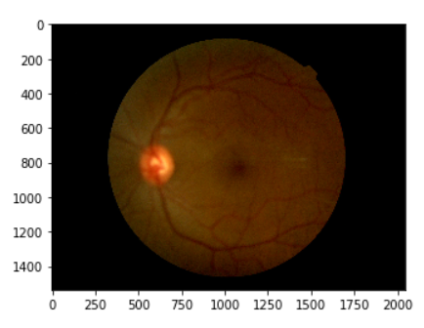
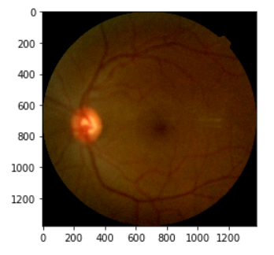
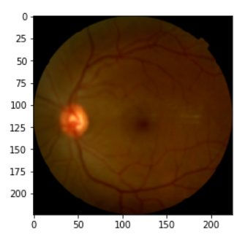
Data Transformation
Original Image
Crop image from gray
Resize(224, 224)

Slide 16
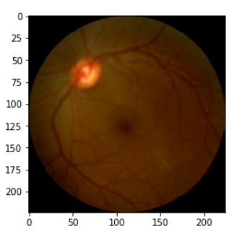
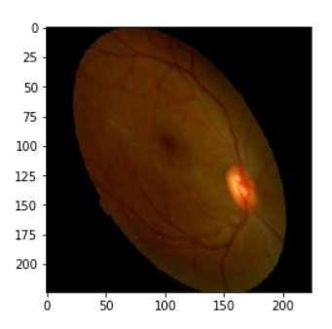
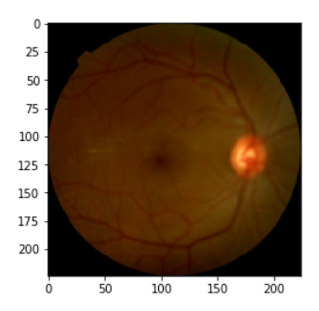
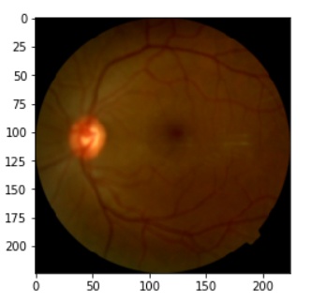
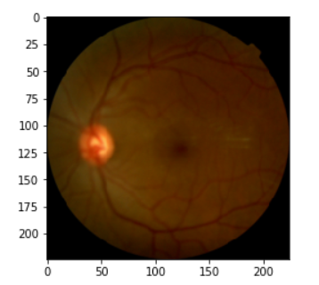
Data Transformation
Random Rotation
( -120, 120)
Random Affine
Random Horizontal Flip
Color Jitter (brightness & contrast adjustment)
Random Vertical Flip
Notes:
RandomRotation((-120, 120))
RandomAffine(degrees=(-180, 180), scale=(0.8889, 1.0), shear=(-36, 36))
RandomHorizontalFlip(p=0.5)
RandomVerticalFlip(p=0.5)
ColorJitter(brightness=0, contrast=(0.9, 1.1), saturation=0, hue=0)

Slide 17
Modeling and Hyperparameter Tuning
5

Slide 18
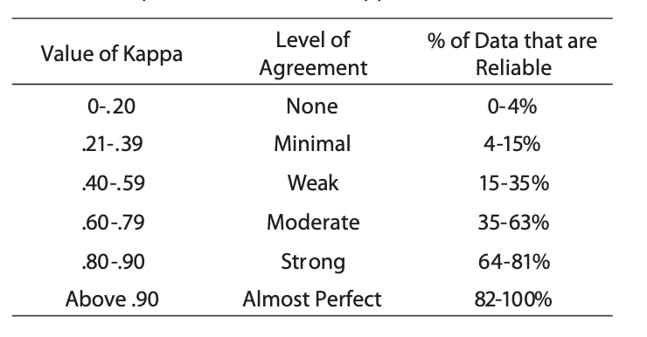
Evaluation Metrics
QUADRATIC WEIGHTED KAPPA (QWK)
The score to measure the agreement between two ratings.
Range: 0 (No agreement between two raters) to 1
( Complete agreement between two raters)
Calculation Process:
1) Matrix O including the number of images received a rating i by A and j by B. And N by N matrix of weights is calculated based on the difference between rater’s scores.
2) Matrix of Expected ratings E is calculated as the outer product between each rater’s histogram vector of ratings and normalized.
Table: Suggested Cohen’s Kappa Criteria by McHugh, Mary. (2012)
Notes:
As we said before, this is

Slide 19
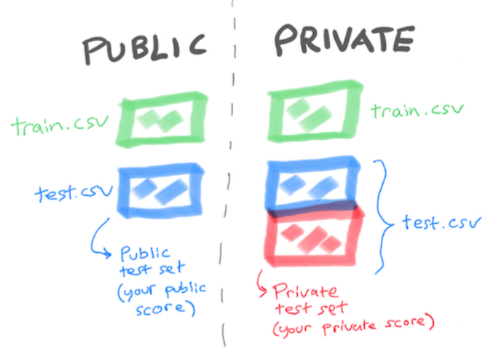
Evaluation Metrics_2
Valid Score (QWK): Training Set
Public Test Score (QWK):
Public Test Set
Private Test Score(QWK): Private Test Set
(largest dataset)

Slide 20
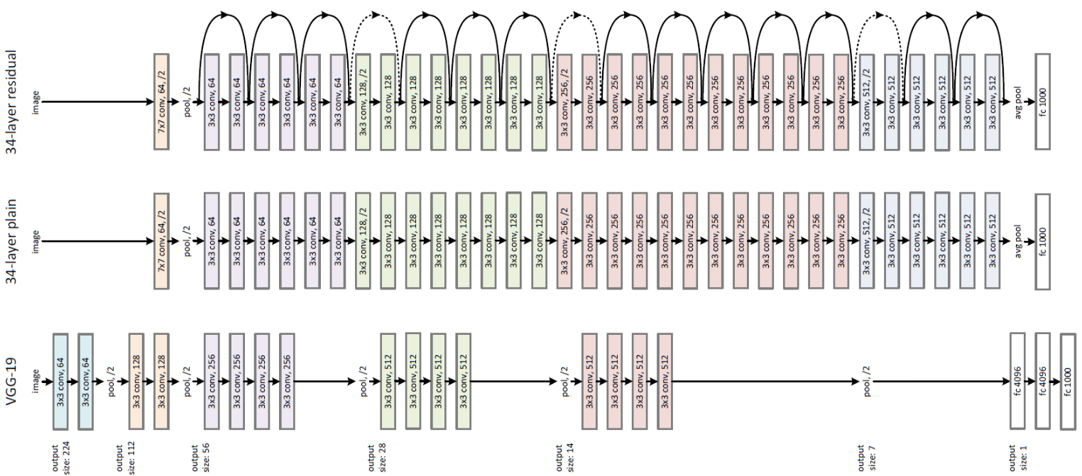
Baseline Model-ResNet101
Winner ILSVRC 2015 – Kaiming He et al.
Pretrained on ImageNet
Include three types of skip/shortcut connections
No fully connected layers at end of network
Bottleneck design to solve the problem of vanishing/exploding gradients
ResNet101 is with 101 layers
34-layer ResNet with Skip/Shortcut Connection(Top), 34-layer Plain Network(Middle), 19-layer VGG-19(Bottom)

Slide 21
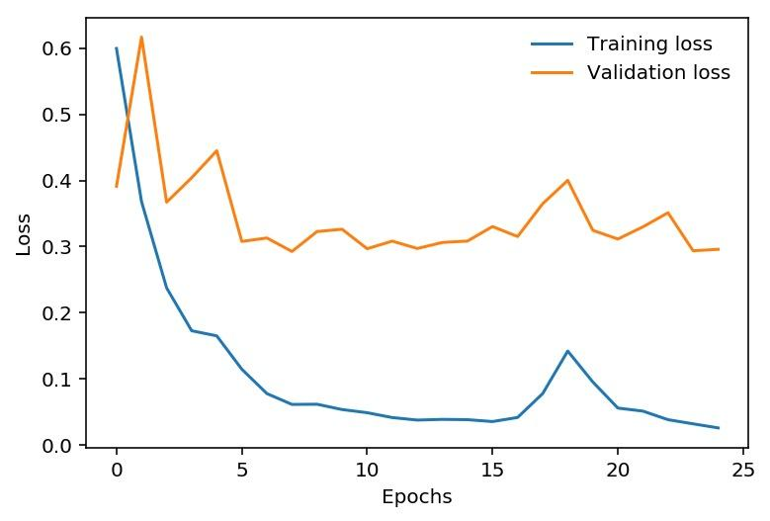
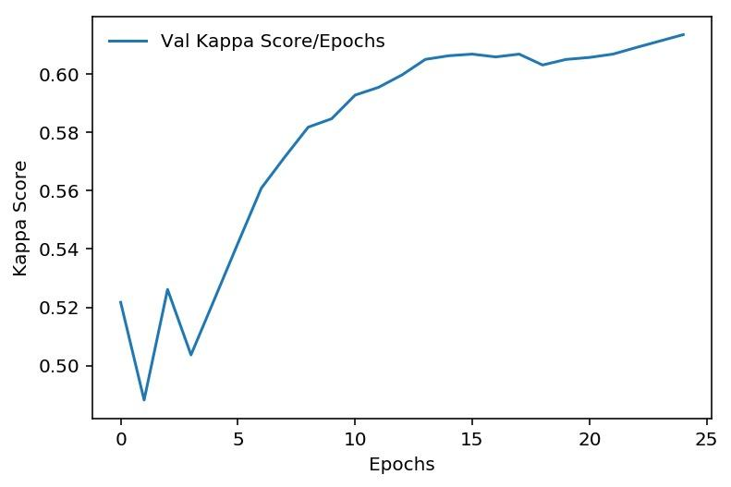
Baseline Model-ResNet101
Pure Vanilla-No Transformation
Minimal Loss:
Train: Epoch 25 0.026
Valid: Epoch 25 0.300
Highest valid kappa Score: 0.614
Kaggle scores:
Private: 0.890
Public: 0.709

Slide 22
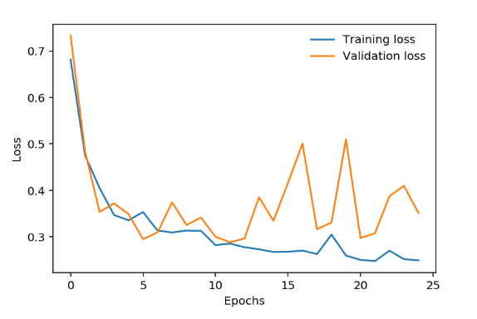
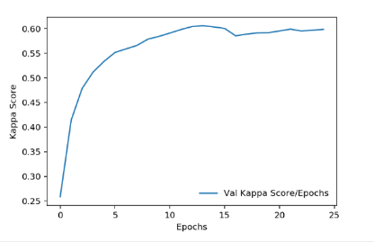
Baseline Model-ResNet101
With Transformation
Highest Kappa Score: 0.606
Kaggle scores:
Private: 0.881
Public: 0.730
Minimal Loss:
Train: Epoch 25 0.248
Valid: Epoch 25 0.300
Notes:
Why with trans

Slide 23
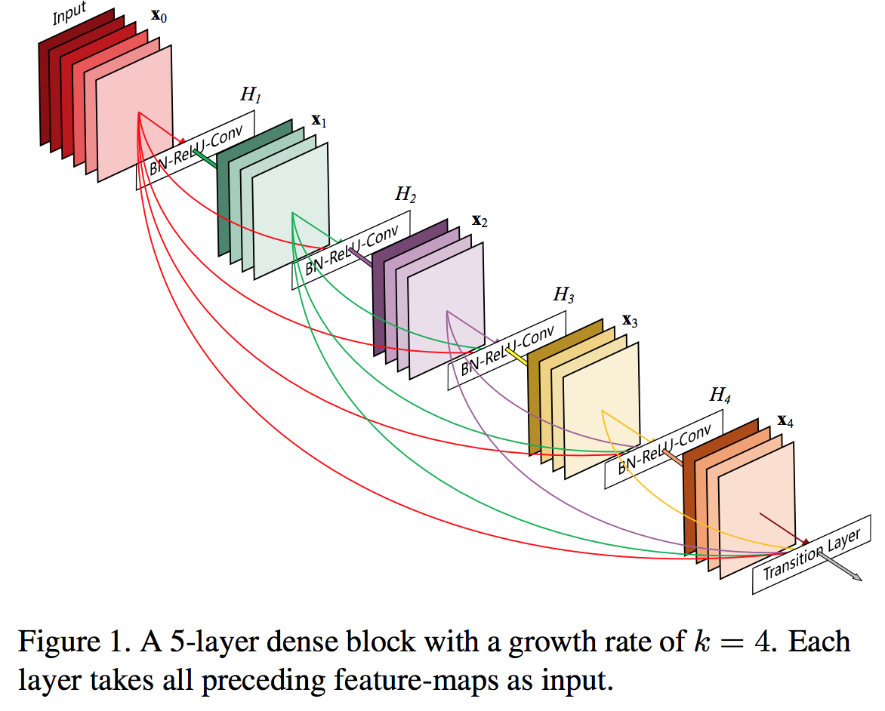
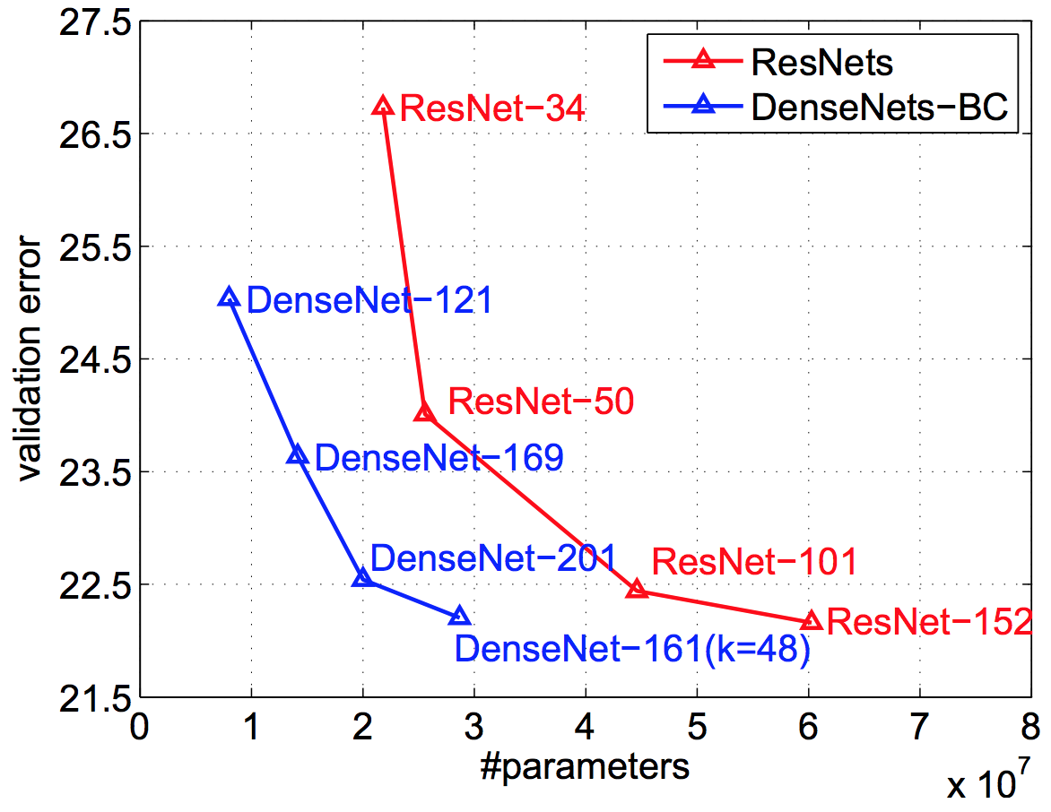
Second Model-DenseNet121
CVPR 2017 Best Paper Award, pre-trained on ImageNet
Dense Convolutional Network (DenseNet) connects each layer to every other layer in a feed-forward fashion.
Advantages: increase feature reuse, reduce number of parameters
Notes:
For example, densenet121 has four dense blocks, which have 6, 12, 24, 16 dense layers respectively. With repetition, it is not that difficult to make 112 layers though

Slide 24
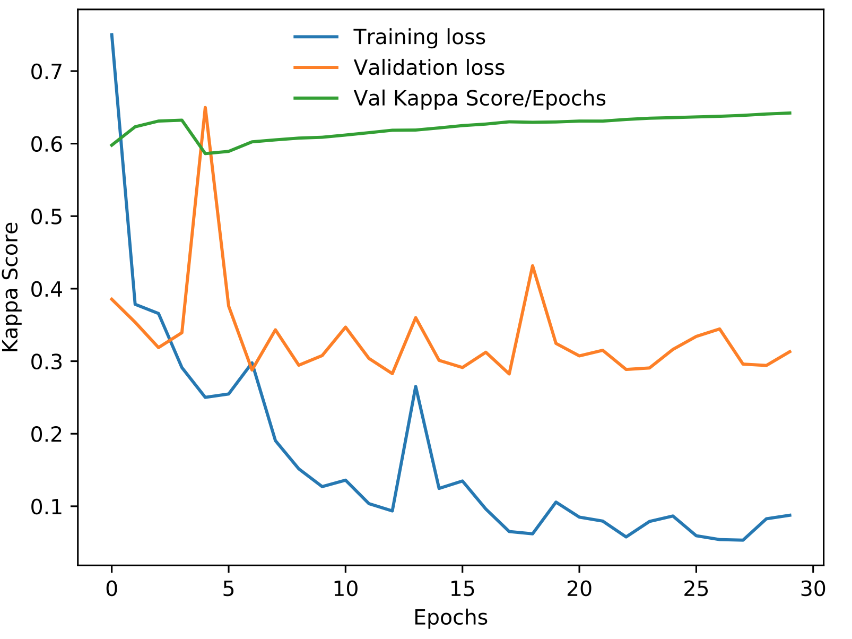
Second Model-DenseNet121
Minimal validation loss:
Epoch 18, 0.282
Highest valid kappa score:
Epoch 30, 0.642
Kaggle scores:
Private: 0.870
Public: 0.684

Slide 25
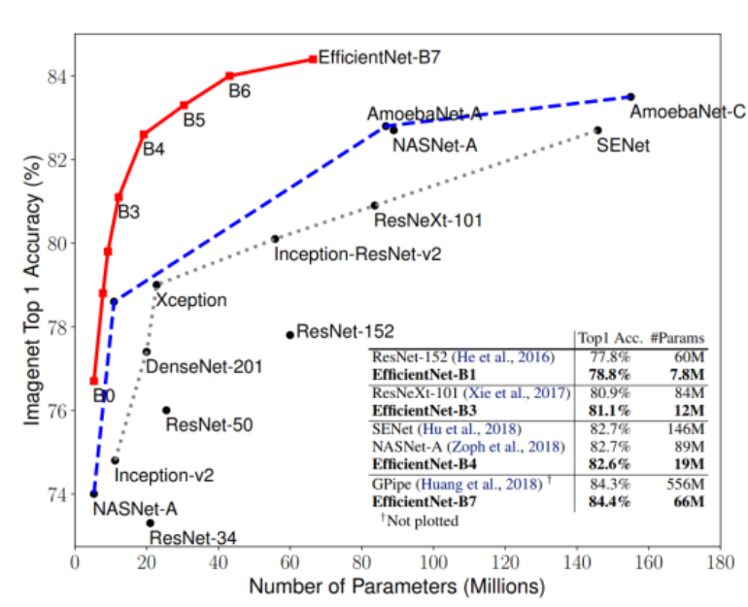
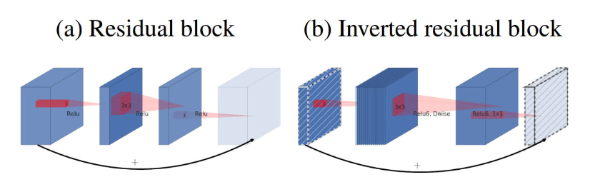
Third Model-EfficientNet-B4
The Network is 8.x smaller, 6.1x faster and better score on ImageNet.
It introduces mobile inverted bottleneck and connects a much fewer parameters
squeeze-and-excitation(SE) optimization

Slide 26
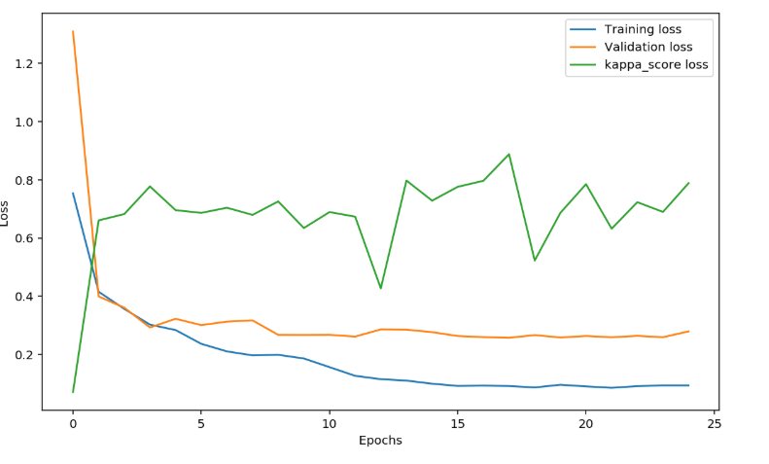
Third Model-EfficientNet-B4
Minimal training loss: 0.0858
Minimal validation loss: 0.258
Highest Valid kappa score: 0.888
Kaggle scores:
Private: 0.902
Public: 0.756

Slide 27
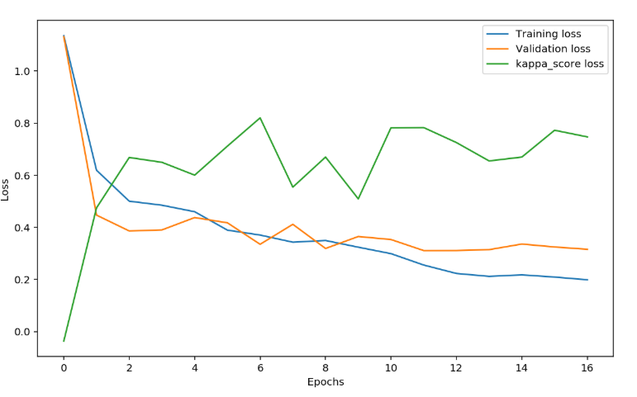
Third Model-EfficientNet-B4 for balanced data
Minimal training loss: 0.199
Minimal validation loss: 0.311
Highest valid kappa score: 0.823
Kaggle scores:
Private: 0.828
Public: 0.710

Slide 28
Model Comparison
Model | QWK (Valid) | QWK (Public) | QWK (Private)
ResNet101(Vanilla) | 0.614 | 0.709 | 0.890
DenseNet121 | 0.642 | 0.684 | 0.869
EfficientNet-B4 | 0.888 | 0.759 | 0.902

Slide 29
Further Studies
6

Slide 30
Further Studies
Hyperparameter Tuning
Tuning the hyperparameter in the current model and apply other CNN models to experiment the results.
Data Augmentation
Conduct other potential data augmentation methods shared by other top winners, such as Fliplr, Zoom etc.

Slide 31
References
Kaggle: https://www.kaggle.com/c/aptos2019-blindness-detection/overview
McHugh, Mary L. "Interrater reliability: the kappa statistic." Biochemia medica: Biochemia medica 22.3 (2012): 276-282.
He, Kaiming, et al. "Deep residual learning for image recognition." Proceedings of the IEEE conference on computer vision and pattern recognition. 2016.
Huang, Gao, et al. "Densely connected convolutional networks." Proceedings of the IEEE conference on computer vision and pattern recognition. 2017.

Slide 32
Thanks!
Any questions?

